Slide 1






:You are about to see:
1). Country Specific details:
United Kingdom
Germany
Denmark
Hungary
Poland
Norway
Belgium
2). Comparative study
3). Next Move

Slide 2
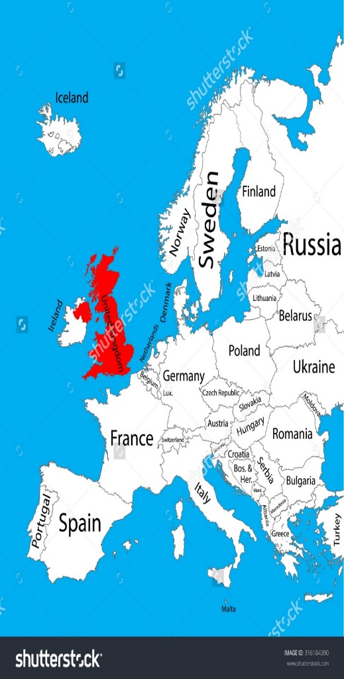
UNITED KINGDOM
United Kingdom (UK) or Britain, is a sovereign country in western Europe.
Lying off the north-western coast of the European mainland,
The United Kingdom includes the island of Great Britain, the north-eastern part of the island of Ireland and many smaller islands.
Northern Ireland is the only part of the United Kingdom that shares a land border with another sovereign state‍—‌the Republic of Ireland
England, Wales, and Scotland also make up Great Britain, and with Northern Ireland they called United Kingdom
Capital: London
Population: 65,511,098
Official Language: English
Currency:- Pound sterling
Employment rate: 74.9%(16-64 age group) (32.01million people)
Unemployment rate: 4.5%(1.49million)

Slide 3

Resource database
The current population of the United Kingdom is 65,511,098.
The United Kingdom population is equivalent to 0.87% of the total world population.
81.9 % of the population is urban.
England having a significantly higher population density than Wales, Scotland and Northern Ireland.
Year | Population | ∆ | Migrants | Density | Urban Pop% | Country’s share in world population | UK Global Rank
2017 | 65,511,098 | 0.61% | 180,000 | 271 | 81.9% | 0.87% | 21
2016 | 65,111,143 | 0.61% | 180,000 | 269 | 81.7% | 0.88% | 21
2015 | 64,715,810 | 0.63% | 180,000 | 268 | 81.5% | 0.88% | 21

Slide 4
Education
United Kingdom has high literacy rate (99% at age 15 and above).
Education is mandatory from ages five to sixteen.
Education in England is the responsibility of the Secretary of State for Education.
Education in Scotland is the responsibility of the Cabinet Secretary for Education and Lifelong Learning.
The Welsh Government has responsibility for education in Wales.
Education in Northern Ireland is the responsibility of the Minister of Education and the Minister for Employment and Learning.
England has the two oldest universities Oxford and Cambridge with history of over eight centuries

Slide 5

:TYPES OF RESOURCES:
:FULL TIME:
In some companies, workers who work 30 hours and above might be customarily regarded as full-time, whereas in another company it might be only workers who work more than, 35 hours a week. There were 23.25 million people working full-time
:PART TIME:
To be considered as a part-time worker in your company, you have to be identified as someone who is not customarily regarded as full-time. ‘Zero hours’ contract workers and workers with ‘hours-to-be-agreed’ contracts are likely to be considered ‘part-time’ workers under the regulations. There were 8.55 million people working part-time.

Slide 6

Taxes
The annual changes to tax and duty form a law called the Finance Act.
Taxation in the UK usually involves payments to the central government agency called Her Majesty’s Revenue and Customs (HMRC) and local councils. Local councils collect a tax called business rates from businesses and council tax from households.
HMRC is a non-ministerial department of the UK Government responsible for the collection of taxes, the payment of some forms of state support, and the administration of other regulatory regimes including the national minimum wage.

Slide 7
Key principles of the UK corporation tax
A UK limited company pays corporation tax on all its profits from the UK and abroad.
A foreign company with an office or branch in the UK pays corporation tax on profits from its UK activities.
Since 1st April 2015 the corporation tax rate is 20%
A limited company must file annual accounts with Companies House 9 months after the company’s financial year ends at the latest.
A limited company with profits up to £1.5 million normally must pay corporation tax 9 months and 1 day after the company’s accounting period ends and file a company tax return 12 months after the company’s financial year ends.
Four equal instalments are normally required for profits exceeding £1.5 million.

Slide 8
Employment taxes in the UK
Employers have to deduct personal income tax and national insurance contributions from employment via a system called PAYE (Pay As You Earn),which means that tax is automatically deducted from your salary each month.
Other deductions businesses may need to make include student loan repayments or pension contributions.
Businesses need to register as an employer with HM Revenue and Customs to get a login for PAYE Online or authorise an agent such as an accountant.
Employers are legally responsible for completing all PAYE tasks even if an agent is getting paid to do them.
A non-resident company can’t set up a standard payroll scheme until it has business premises in the UK.
Businesses must pay the PAYE bill to HM Revenue and Customs by the 22nd of the month for all the salaries paid the previous month.

Slide 9
Income Tax rates and Band
Band | Taxable Income | Tax Rate
Personal Allowance | Upto £ 11,500 | 0%
Basic Rate | £11,501 to £ 150,000 | 20%
Higher Rate | £ 45,001 to £ 150,000 | 40%
Additional Rate | Over £ 150,000 | 45%
The current tax year is from 6 April 2017 to 5 April 2018.
The standard Personal Allowance is £11,500, which is the amount of income you don’t have to pay tax on.

Slide 10
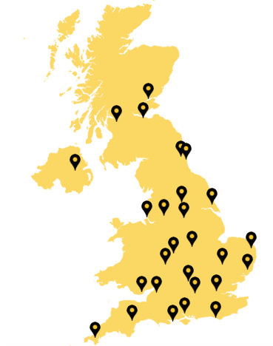
Major Tech cities Covered
Details | Numbers
Total Number of Cities Targeted | 16
Total Number Companies Found | 70

Slide 11
:Details found for:
Places
Company name
Sector/field
Address and Contact Information
Person to Contact
Important Website
Email
Size of company (employee)
Size of the company(revenue)
Opening status

Slide 12
Sector and Companies details

Slide 13
Major Industries
Total Companies Found | 70
Consultancies | 17
Product based | 10
Services based | 7
Product and services based | 35

Slide 14
Sector or field wise distribution

Slide 15
Size of the company(Employee)

Slide 16
Size of the company(Revenue)

Slide 17
Status of Companies approached for their respective openings
No Company has been approached in UK for their respective opening, hence there might be the bright chances for cutting a great deal.
Consultancies are available in good number, in UK. But, in case of cost cutting, companies might be interested in offshore centres.

Slide 18
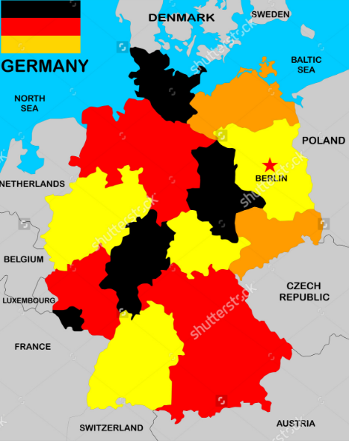
Germany
Capital: Berlin
There are three city states – Berlin, Hamburg and Bremen.
Currency : EURO
Official Language: German, English
Germany is the fifth largest country in Europe, covering an area of 357,022 square kilometres; only the Ukraine, France, Spain and Sweden are bigger.
With about 82 million inhabitants, Germany is the most populous member state of the European Union.
Germany shares borders with nine other countries: Denmark, Poland, the Czech Republic, Austria, Switzerland, France, Belgium, Luxembourg and the Netherlands.

Slide 19
Details of Demography
Particular
Population | 82million
Major Population categories | Christian, Muslims, Jews
Migrants | 222,395
Employment Rate | 75.1% of working age or 43.3 million
Unemployment rate | 7.7%
German SMEs | 52% of entire economic output
Major contributors of GDP | Service Sector(71%)+Industry(28%)+Agriculture(1%)

Slide 20
Taxation in Germany
Taxable income range for single taxpayers(EUR) | Taxable income range for married taxpayers (EUR) | Tax rate(%)
 |  | 0
 |  | 14
 |  | 42
Over | Not over
Over | Not over
0 | 8652
0 | 17,304
17305 | 107,330
107,331 | 508,892
508,893 | And above
8653 | 53665
53666 | 254,446
254,447 | And above
 |  | 45
All German residents are liable to income tax on their worldwide income and assets. Non-residents are subject to German income tax in respect of German-source income.
Note: The rates are before solidarity tax (5.5% maximum)

Slide 21
Companies details
Total No. Of cities targeted | 38
Total No. of companies found | 123
Number of companies approached till date | 63
Companies with +ve response | 4-5
Companies with -ve response | 2-3
Companies with no response | 55-57

Slide 22
Opening Status

Slide 23
Sector wise companies distribution

Slide 24
:Details found for:
City
Company
Type
Sector/field
Address and contact information
Person to contact
Multinational presence
Important websites
email address
Nature of Work
Status

Slide 25
Status of Companies approached for their respective openings
63 Companies has been approached in Germany for their respective opening.
Out of 63, 4-5 Companies have shown their interest for business.
Still, many companies are there , for positive response.
Consultancies are available in good numbers, in Germany.
But, in case of cost cutting, companies might be interested in offshore centres.

Slide 26
Denmark
!!Sorry!!
No data available on Taxation, Social Security and Relocation

Slide 27
Company details
Total No. Of cities targeted | 23
Total No. of companies found | 39
Number of companies approached till date | 0
Companies with +ve response | 0
Companies with -ve response | 0
Companies with no response | 0

Slide 28
Opening status

Slide 29
Size of the company(Employee)

Slide 30
Size of the company(Revenue)

Slide 31
:Details found for:
City
Company
Sector/field
Important Website
Size of company (employee)
Size of the company(revenue)
Opening status

Slide 32
Status of Companies approached for their respective openings
No company has been approached in Denmark,
Again there are bright chances to crack a nice deal, based on our resources, in Denmark.

Slide 33
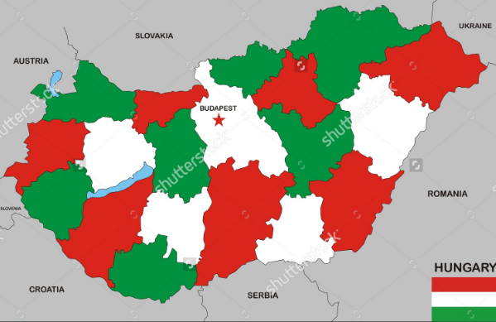
HUNGARY
Area - 93,030 square kilometres.
Capital- Budapest.
Currency- Hungarian forint.
1 Hungarian Forint equals = 0.23 Indian Rupee
Language: Hungarian, English, German, Russian, Romanian, French.
International rankings: 20th in quality of life, 19th safest country in the world.
Population: 99.37million

Slide 34
Resources Database
FULL TIME
Involves eight hours’ work a day, and 40 hours a week.
Regulations on employment or the agreement of the parties may establish longer working hours (though not exceeding 12 hours a day and no more than 60 hours a week).
PART TIME
Shorter daily working hours than usually applicable to the given position in full-time work.
Employed Persons | 4378037 (67.5%)
Unemployed Persons | 209045
Retirement age (Women) | 62.50
Retirement Age (Men) | 62.50
Full Time Employment | 4157000
Part time Employment | 201000

Slide 35
Taxes
Employer Taxes | Corporate Taxes
Tax for an individual who meets the criteria of a "permanent resident" in Hungary will be calculated on his income in Hungary and abroad. | Corporate income tax rate is 9% from 1 January 2017.
A foreign resident who is employed in Hungary pays tax only on his income earned in Hungary
Income tax in Hungary is levied at a flat rate of 15%

Slide 36
Company details
Total No. Of cities targeted | 2
Total No. of companies found | 22
Number of companies approached till date | 0
Companies with +ve response | 0
Companies with -ve response | 0
Companies with no response | 0

Slide 37
Opening Status

Slide 38
Size of the company(Revenue)

Slide 39
Size of the company(Employees)

Slide 40
Status of Companies approached for their respective openings
No company has been approached in Hungary

Slide 41
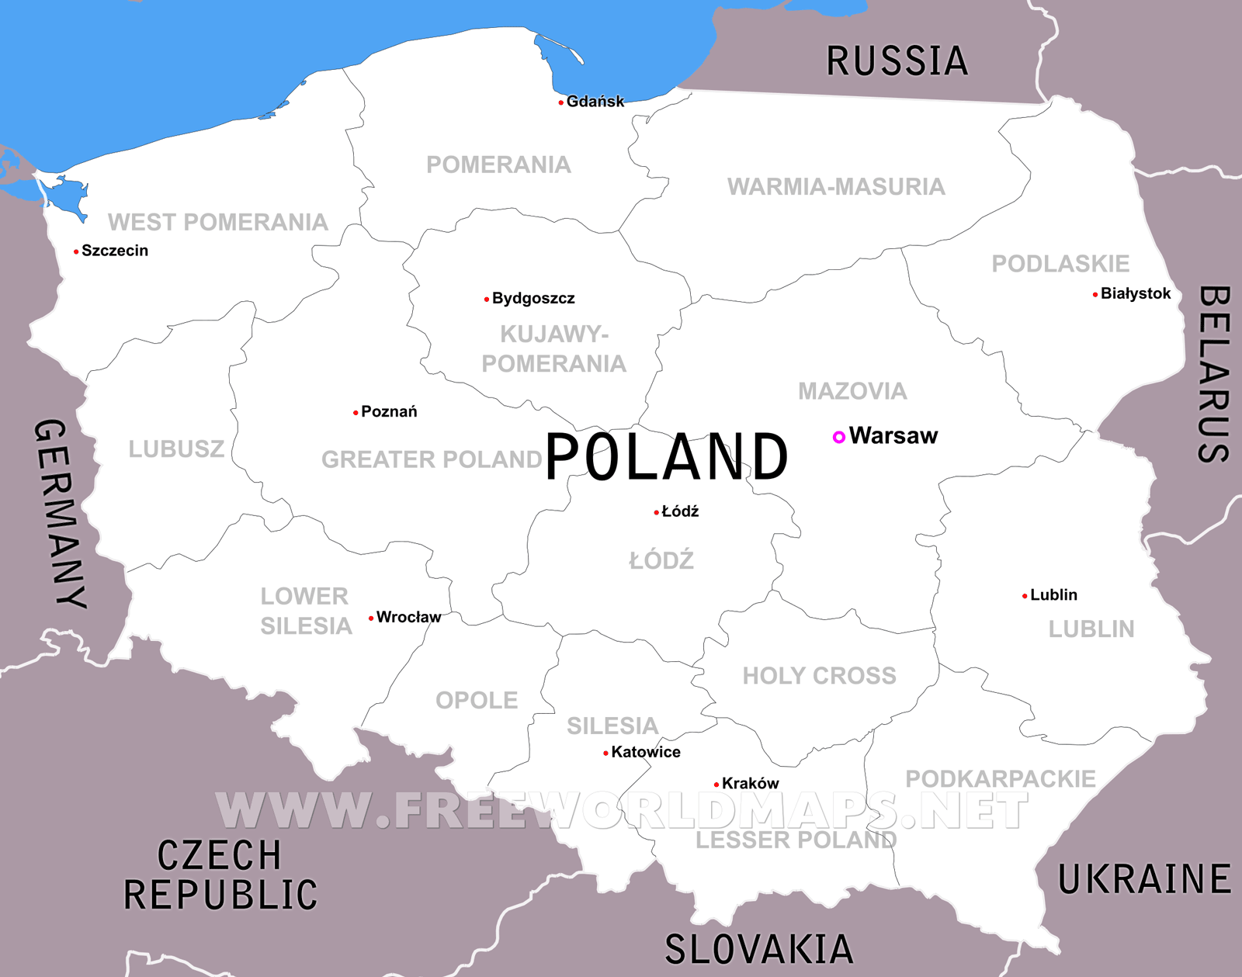
Poland
POPULATION : 38.6 million.
OFFICIAL LANGUAGE : Polish
CAPITAL CITY : WARSAW
MONETORY UNIT: Zloty (PLN)
LITERACY RATE : 99.7 %
Important Industries : Machine building, Iron and steel, Coal mining, Chemicals , Shipbuilding, Food processing, Glass, Beverages and Textiles
Poland borders seven countries: Germany on the west, Czech Republic and Slovakia on the south, Ukraine, Belarus and Lithuania on the east, and Russia on the north.

Slide 42
Tax Slabs
Employers Taxes | Corporate Taxes
Upto 85,528 PLN | 18%
Over 85,528 PLN | 32%
Corporate Income Tax(CIT) | 19%
Reduced CIT | 15%
*Reduced CIT (For Companies in the first year of activity or with turnover under EUR 1.2 Million in the previous year)

Slide 43
Company details
Total No. Of cities targeted | 10
Total No. of companies found | 31
Number of companies approached till date | 0
Companies with +ve response | 0
Companies with -ve response | 0
Companies with no response | 0

Slide 44
Opening status

Slide 45
Sector Wise company Distribution

Slide 46
Size of the company (Revenue)

Slide 47
Size of the company(Employees)

Slide 48
Status of Companies approached for their respective openings
No company has been approached in Poland

Slide 49
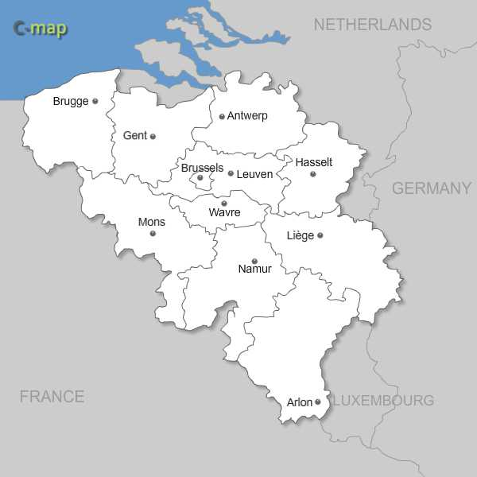
Belgium
POPULATION : 11,250,585
OFFICIAL LANGUAGE : Dutch, French and German
CAPITAL CITY : Brussels
MONETORY UNIT: Euro
LITERACY RATE : 99 %

Slide 50
Company details
Total No. Of cities targeted | 12
Total No. of companies found | 25
Number of companies approached till date | 0
Companies with +ve response | 0
Companies with -ve response | 0
Companies with no response | 0

Slide 51
Opening status

Slide 52
Sector Wise company Distribution

Slide 53
Size of the company (Revenue)

Slide 54
Size of the company(Employees)

Slide 55
Status of Companies approached for their respective openings
No company has been approached in Belgium

Slide 56
Comparative study
Metrics we have selected for comparison are as follows
Demographic Dividend
Population Growth
Population Age mix
Ethnic Markets
Expatriats
Demographic dividend occurs when the proportion of working people in the total population is high because this indicates that more people have the potential to be productive and contribute to growth of the economy.
Resources
Taxes
Social Security
Cost of living
Salaries
Companies density in different cities of the Country

Slide 57
Metrics
Population Growth (∆) | 0.61% | 0.5% | 0.6% | -0.2% | -0.0% | 1.1% | 0.5%
Population Age mix 0-15 16-64 Over 65 | 18.8% 63.5% 17.7% | 13.9% 66.1% 19.6% | 18.1% 65.8% 16.1% | 15% 69.3% 15.8% | 14.8% 71.7% 13.5% | 18.8% 66.2% 15.0% | 16.1% 66.3% 17.6%
Ethnic Markets | White British(87.1%), Gypsy(0.1%), Asian(6.9%), Black British(3.0%) | German(80%), Turk(3.7%), pole(1.9%), Russian(1.5%), Italian(1%), African(1%), Others(9.3%) | Danish(97%), Scandinavian(2%) | Hungarians(83.7%), Romani(3.1%), German(1.3%), Others or Undeclared(11.1%) | German(49,000), Belorussian(37,000), Ukrainian(36,000), Roma(12,000), Russian(8000) | Norwegian(94.4%), Other European(3.6), Others(2%) | Flemish Speaking Belgian(53.6%), French Speaking(36.4%),Italian(1.6%), French(1.2%), Dutch(1.2%)
Indian Expatriates | 1500,000 (approx.) | 161,000 | 23,000 | 1000 | 4000 | 7300 | 18,000

Slide 58
Metrics
Resources (IT Population) Full time Prof. Part time Prof. | NA 23.25 Million 8.55 Million | 960,000 2997,400 10,794,000 | NA 2027.90 Thousand | 160,000 4157,000 2020,000 | 140,000 14,959.80 Thousand 1054.20 Thousand | NA 1882.30 Thousand
Salaries (Median) | $ 39,029.45 | $56,996.05 | $73,433 | $26,796 | $ 24,215.67 | $ 67,465 | $61,838.59
Companies density in different cities of the Country (Largest to Smallest) | London(30), Edinburg(4), Reading(4), Berkshire(2), Cambridge(2), Lisburn(1) | Berlin(18), Munich(16), Frankfurt(4), Bayern(2), Stuttgart(3) | Copenhagen(17), Soro(1) | Budapest(21), Veszprem(1) | Warsaw(10), Wroclaw(7), Krakow(5), Lodz(2), Zielonka(1) | Oslo(25), Haugesund(5), Ribadu(3), Sandefjord(1) | Brussels(11), Leuven(3), Antwerp(2), Mortsel(1)
Literacy | 99% | 99% | 99% | 99.1% | 99.7% | 100% | 99%
Unemployment | 4.8% | 2497000 | 6.2% | 209045 | 6% | 4.7% | 7.6%
Ease of doing business | 7 | 17 | 3 | 41 | 24 | 6 | 42

Slide 59
Metrics
Personal Tax | UPTO $ 14,555.75 – 0% $ 14,553.60 - $ 56,957.40 – 20% $ 56,953.27 - $ 189,840.00 – 40% OVER 189,840 – 45% | (SINGLE) 0- 9919.09$: 0 % 9920.09- 61524.24:14% 61525.24- 291709.62 : 42% 291710.62and above : 45% (MARRIED) 0-17,304$ : 0% 17,305$-107,330 $: 14% 107,331$-508,892$ : 42% 508,893$ and above: 45% | 0 to $ 7,368.75 – 8% $ 7368 – $ 78,552.23 – 40.96% OVER $ 78,552 – 56.48% | Flat 15% | UPTO $ 22,833.95 – 18% OVER $ 22,833.95 – 32% | From $ 19372.66 – 0.93% From $ 27264.57 – 2.41% From $ 68580.45 – 11.52% Above $ 110320.45 – 14.52 % | Up to EUR 10,860 25 percent EUR 10,860–12,470 30 percent EUR 12,470–20,780 40 percent EUR 20,780–38,080 45 percent EUR 38,080+ 50 percent
Corporate Tax | 19% | 29.72% | 22% | 9% | 19% | 27% | 33%

Slide 60
Cost of Living
Accommodation | Apartment (1 bedroom) in City Centre –888.22€ 65849.44₹ Apartment (1 bedroom) Outside of Centre- 717.16€ 53167.73₹ | 1 BEDROOM ( in City Centre) 649.43 € 48170.651 ₹ BEDROOM (Outside City Centre) 483.59 € 35869.68₹ | Apartment (1 bedroom) in City Centre – 935.49€ 69385.30₹ Apartment (1 bedroom) Outside of Centre-48665.19₹ 656.13€ | 1 BEDROOM ( in City Centre) 365.78€ 27134.98₹ 1 BEDROOM (Outside City Centre) 254.78€ 18900.64₹ | Apartment (1 bedroom) in City Centre – 404.79€ 30026.58₹ Apartment (1 bedroom) Outside of Centre-312.85€ 23206.71₹ | Apartment (1 bedroom) in City Centre – 1034.68€ 76717.33₹ Apartment (1 bedroom) Outside of Centre- 807.14€ 59846.28₹
Travel | One-way Ticket (Local Transport) –2.72€ 202.01₹ Taxi 1km (Normal Tariff) – 2.26€ 167.91₹ | ONE WAY TICKET 2.70 € 200.27₹ MONTHLY PASS 70.00 € 5192.16₹ TAXI (1km) 2.00 € 148.35₹ | One-way Ticket (Local Transport) –3.09€ 229.40₹ Taxi 1km (Normal Tariff) – 2.05€ 152.10₹ | ONE WAY TICKET 1.14€ 84.57₹ MONTHLY PASS 30.98€ 2297.85₹ TAXI (1km) 0.91€ 67.73₹ | One-way Ticket (Local Transport) – 0.81€ 60.04₹ Taxi 1km (Normal Tariff) -0.52€ 38.85₹ | One-way Ticket (Local Transport) 3.74€ 277.55₹ Taxi 1km (Normal Tariff) -1.47€ 109.04₹
Food | Milk(1 Ltr)-1.00€ 73.99₹ Rice(1kg)- 1.38€ 102.29₹ Eggs (12) – 2.14€ 158.91₹ | MILK (1 liter) 0.69 € 51.18₹ RICE (1kg) 1.54 € 114.23₹ Eggs (12) 1.86 € 137.96₹ | Milk(1 Ltr)- 66.23₹ 0.89€ Rice(1kg)- 132.75₹ 1.79€ Eggs (12) – 3.11€ 230.69₹ | MILK (1 liter) 0.68€ 50.44₹ RICE (1kg) 0.91€ 67.24₹ Eggs (12) 1.47€ 109.08₹ | Milk(1 Ltr)- 0.57€ 42.03₹ Rice(1kg)- 0.75€ 55.63₹ Eggs (12) – 1.56€ 115.49₹ | Milk(1 Ltr)- 1.74€ 128.78₹ Rice(1kg)- 2.51€ 186.44₹ Eggs (12) – 3.58€ 265.18₹
Utilities(Monthly) | Basic (Electricity, Heating, Water, Garbage) for 85m2 Apartment -161.77€ 11992.69₹ | Electricity, Heating, Water, Garbage (monthly) 217.45 € 16129.08₹ Internet (monthly) 24.37 € 1807.61₹ | Basic (Electricity, Heating, Water, Garbage) for 85m2 Apartment – 161.91€ 12009.06₹ | Electricity, Heating, Water, Garbage (monthly) 11087.34₹ 149.46€ Internet (monthly) 13.21€ 980.02₹ | Basic (Electricity, Heating, Water, Garbage) for 85m2 Apartment – 152.81€ 11335.37₹ | Basic (Electricity, Heating, Water, Garbage) for 85m2 Apartment- 158.24€ 11732.61₹

Slide 61
Social Security
Benefits | Housing Benefit Income-based Jobseeker’s Allowance Working Tax Credit Child Tax Credit Income-based Employment and Support Allowance and Income Support. | Health insurance Pension insurance Unemployment insurance Accident insurance. Social indemnity | Health insurance Child allowance Maternity benefit Holiday pay Disability benefit and Sickness benefit. | Health insurance Pension insurance Dental care | Retirement Insurance Disability insurance Sickness Insurance Accident Insurance | National insurance Old-age pension Supplementary pension Special supplementary pension Disability benefits Survivor pension Rehabilitation benefits | allowances in the event of sickness unemployment benefits allowances in the event of incapacity for work through sickness or invalidity allowances in the event of accidents at work allowances in the event of industrial disease family allowances pensions
Contributions | 13.8%(Employer)+12% (£157.01 and £866)2% (above £866) (Employee) | 20.62(Employer)+19.43%(Employee) | (2000Euro/year/Full time employee)+(NIS:8.2%, Pension:5.1%) | 27%Employer)+18.50(Employee) | 19.21-23.91%(EMPLOYER)+13.71(Employee)+ | 14.1(Employer)+8%(Employee)

Slide 62
SWOT analysis of Swedium Global services AB
Strength
Available Technical Resources in India
Weakness
Not Enough Muscle Power to carry out Sales and Marketing in new geographies
Less available people / resources in Europe is an advantage for Swedium to target those market.
People’s commitment is less in India.
A good number of Engineers already in Sweden Via Swedium
Good Clientele: Ericson, Nokia, Intel.
Having office in Sweden positions Swedium as an European Company
No Bench Strength
Threat
Opportunity
Exploring new geography.
Fierce Competition
Constant Changing laws in immigration and trade agreements like Trans pacific pact(TPP) and Brexit

Slide 63
Final Step: Next Move

Slide 66
Comparative Outcome
With Reference to the dashboard, we witnessed that Hungary has better potential to be our target market, due to:
Relative lesser Salaries,
Less personal taxation,
Less corporate taxation, and
Less Cost of living.
So, Hungary should be a better option for our business expansion in Europe Further.
But,
Alternatively, Germany holds the second spot in our options, with better salaries, lower personal taxation and cost of living than UK and Denmark, good number of companies and better geographic location

Slide 67
Questions
The Interpretation on analysis, recommendation and conclusion?
References??
Connection of the report with the objective ?
Unique contribution found out after the research?
What is the future areas in which studies can be conducted and so on.
Why this report have some factual information?

Slide 68
Thank you!!

